Slide 1

Press space for quick boot, macOS for PowerPoint v1.01-2 Beta

Slide 2




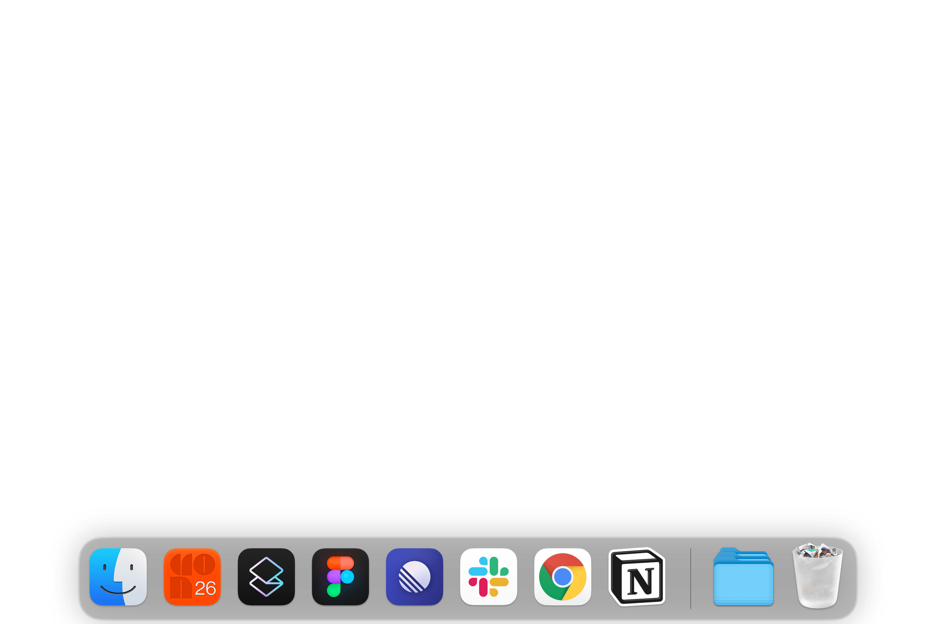
Finder
File
Edit
View
Go
Window
Help
Sat Sep 28 08:01
Update
Crash
macOS for PowerPoint v1.01-2 Beta

Slide 3
Finder
File
Edit
View
Go
Window
Help
Sat Sep 28 08:01
Update Available
Upgrade to macOS Prairie for the latest and greatest experience.
Update
Crash
Upgrade
Ask me later
macOS for PowerPoint v1.01-2 Beta

Slide 4
Finder
File
Edit
View
Go
Window
Help
Sat Sep 28 08:01
Internet
Home_7753
Connected
Update
Crash
macOS for PowerPoint v1.01-2 Beta

Slide 5
Finder
File
Edit
View
Go
Window
Help
Sat Sep 28 08:01
Shutdown?
Yes
No
Crash
macOS for PowerPoint v1.01-2 Beta

Slide 6
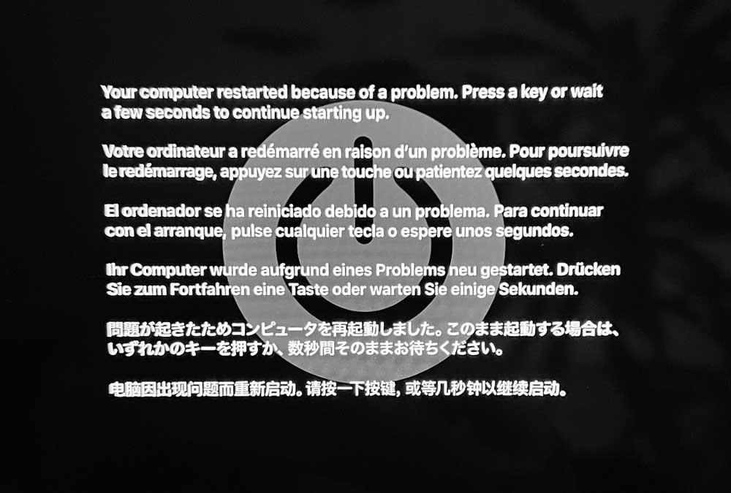
macOS for PowerPoint v1.01-2 Beta

Slide 7

Click here to restart macOS
Click here to exit
Review-of-the-update:
⭐⭐⭐⭐⭐
Stable Release ETA: early-March 2025
macOS for PowerPoint v1.01-2 Beta

